Slide 1
Molecular Dynamics of Complexes
Jack Ustanik

Slide 2
Background Information
Goal
Compare our own docked result to the known crystal structure
Determine if docking was successful
Introduction
Energy minimization ensures potential energy is low and conformation is more realistic
Run Molecular docking simulation to produce many ligand-protein complexes
MD was run on complexes to ensure accuracy of docked complexes
Assessment of structures
Produces a more accurate representation of the ligand-protein complex
Useful for evaluating the stability of a complex
Real life examples: Computational Drug Discovery, Protein Engineering, Binding and Stability

Slide 3
Terms
Molecular Mechanics-generalized Born Surface Area (MMGBSA)
Calculating the free energy of the binding of ligands and proteins
Measure of strength between ligands and proteins
C-alpha atoms RMSD
Measures similarity in protein structures of C-alpha atoms
Protein backbone RMSD
Measure of structural changes in a protein
Larger values indicative of more structural deviations

Slide 4
Procedure
Best Docked (lab3) Vs Crystal Structure
Steps Include:
Energy Minimization
Min solvent, Min all, Emin script
MD simulation
Heating, Equilibration, Production, MD scripts
Binding Energy Analysis
Analyze MD simulation trajectory
Generate Average Structure
Creating MD movies

Slide 5
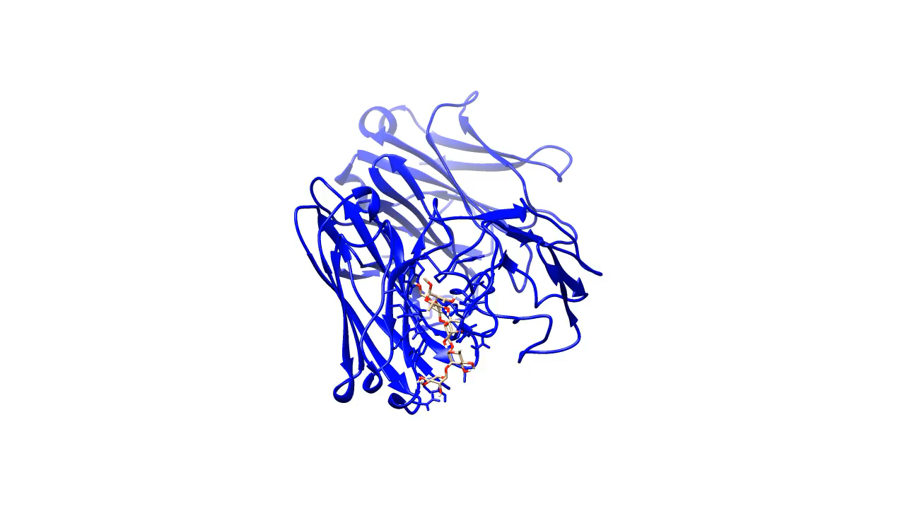
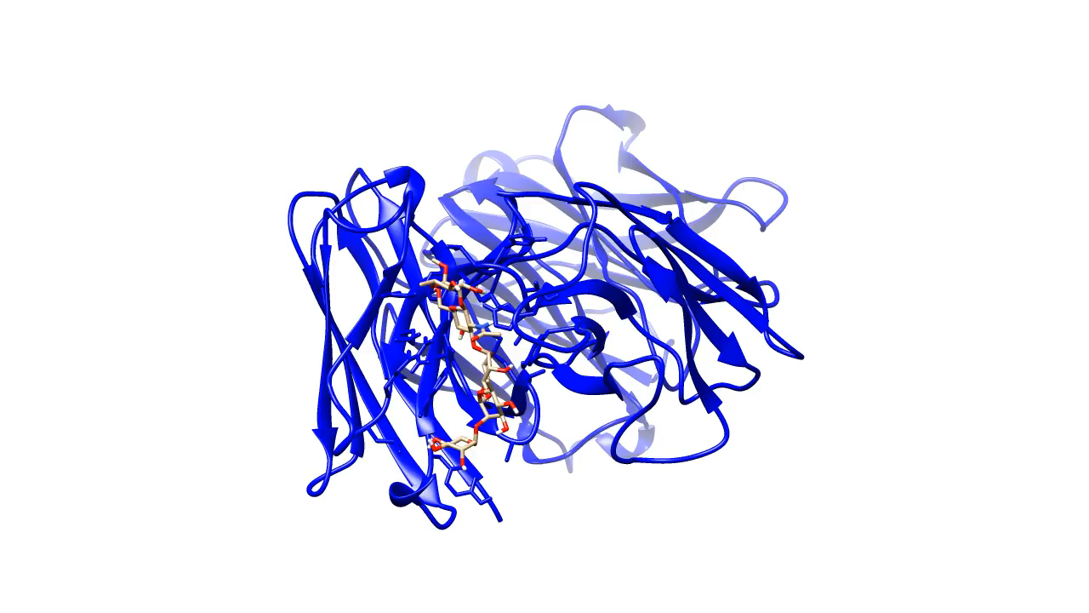
MD simulations
1m7i Crystal Best Docked

Slide 6
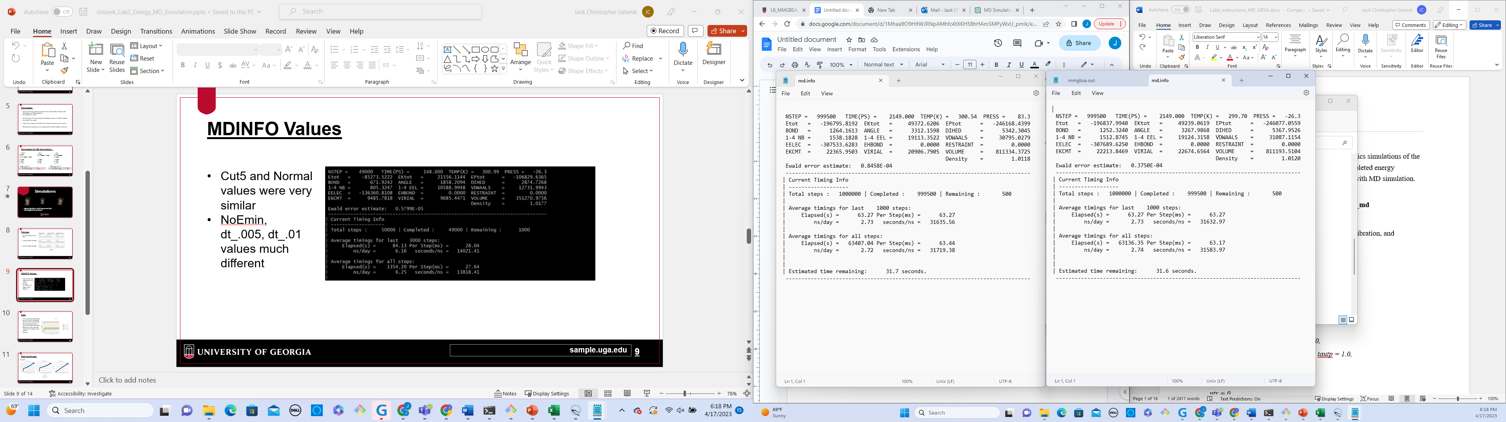
MD Info
Values Nearly the same between Best Docked and 1m7i_crystal structures
md.info of Best Docked md.info of 1m7i Crystal Structure

Slide 7
Structures with Different RMSD Values
Convergence has not been reached
Large fluctuations in RMSD value or ever increasing RMSD value

Slide 8
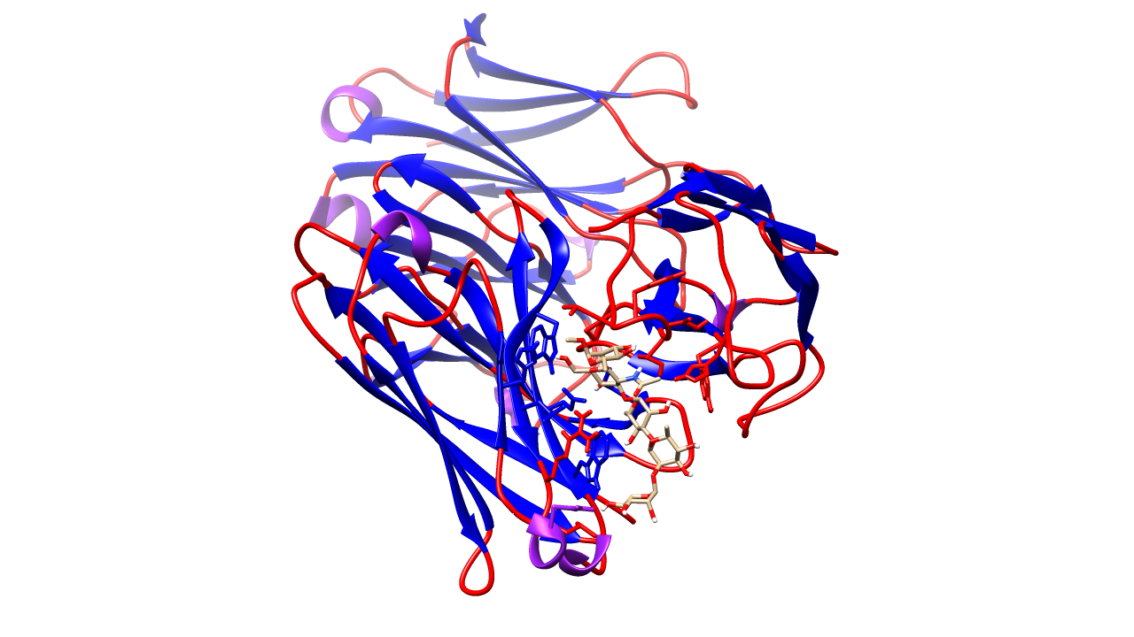
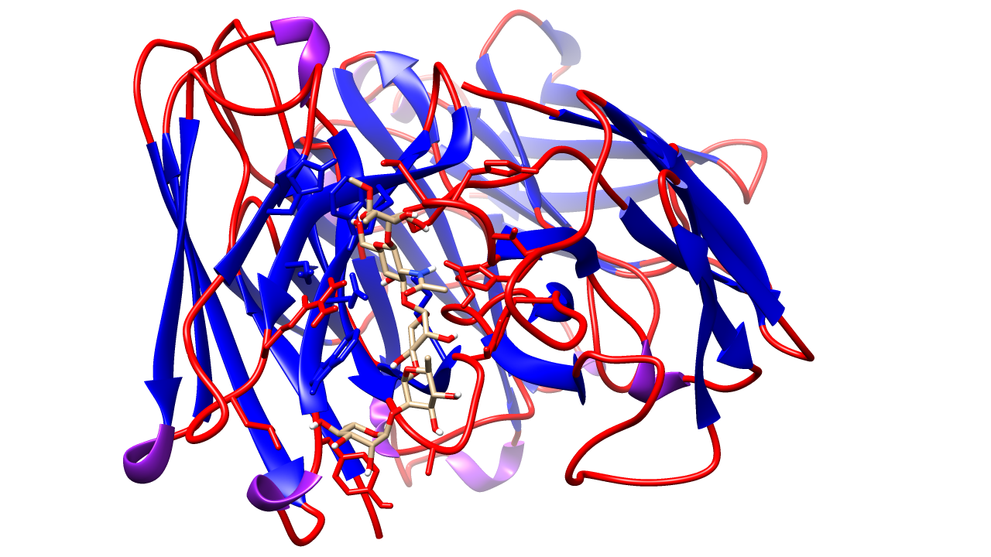
Average Strucutes
1M7I Best Docked

Slide 9
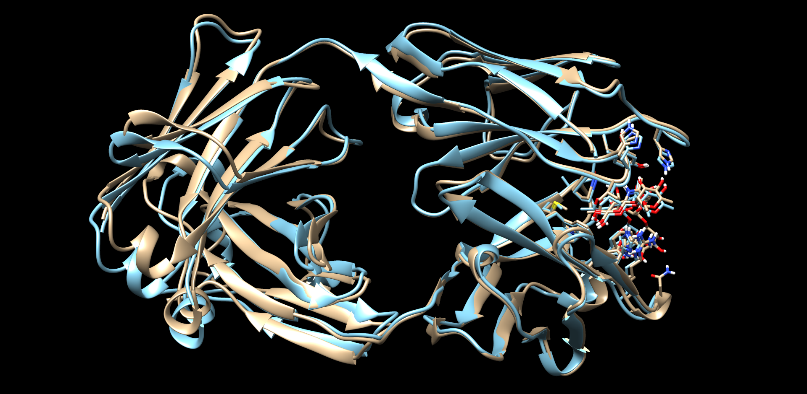
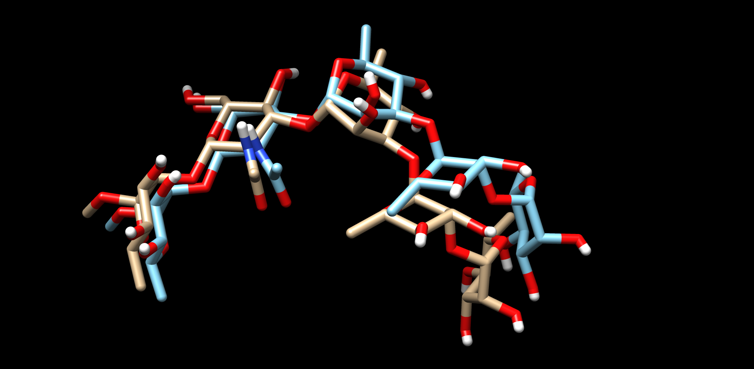
Averages of Both Structures
Deviations in average structure across Best Docked (Blue) and 1m7i (Grey)

Slide 10
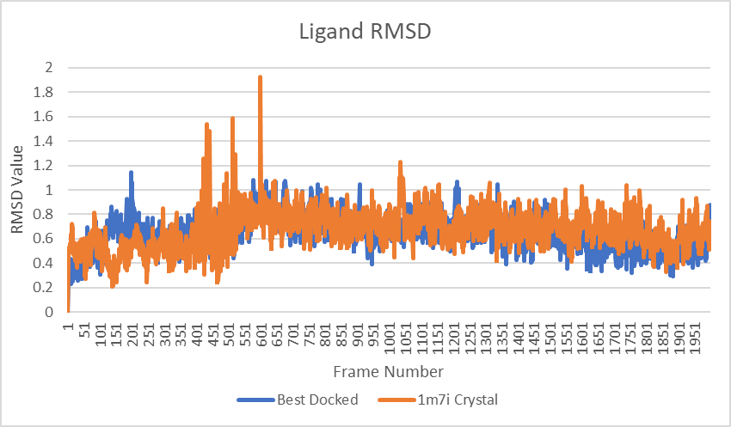
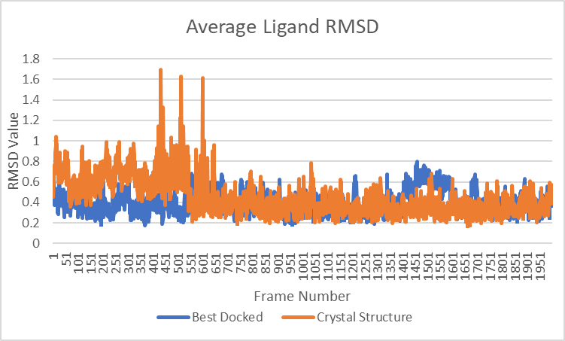
Ligand RMSD vs Average Ligand RMSD
Average Ligand Structure Producing move favorable RMSD values

Slide 11
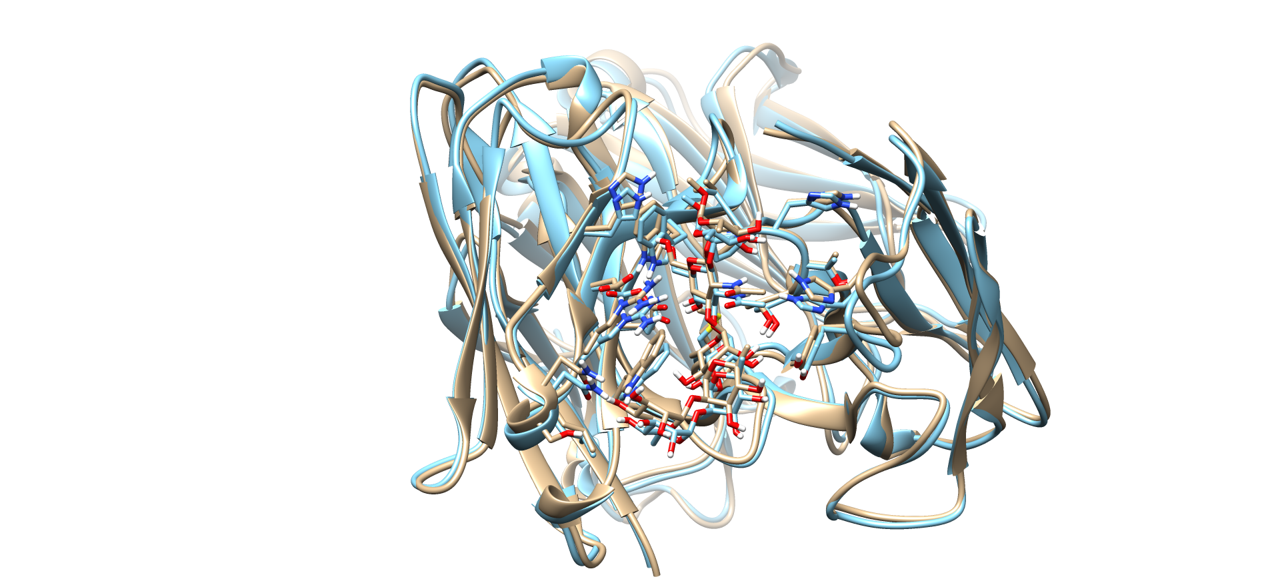
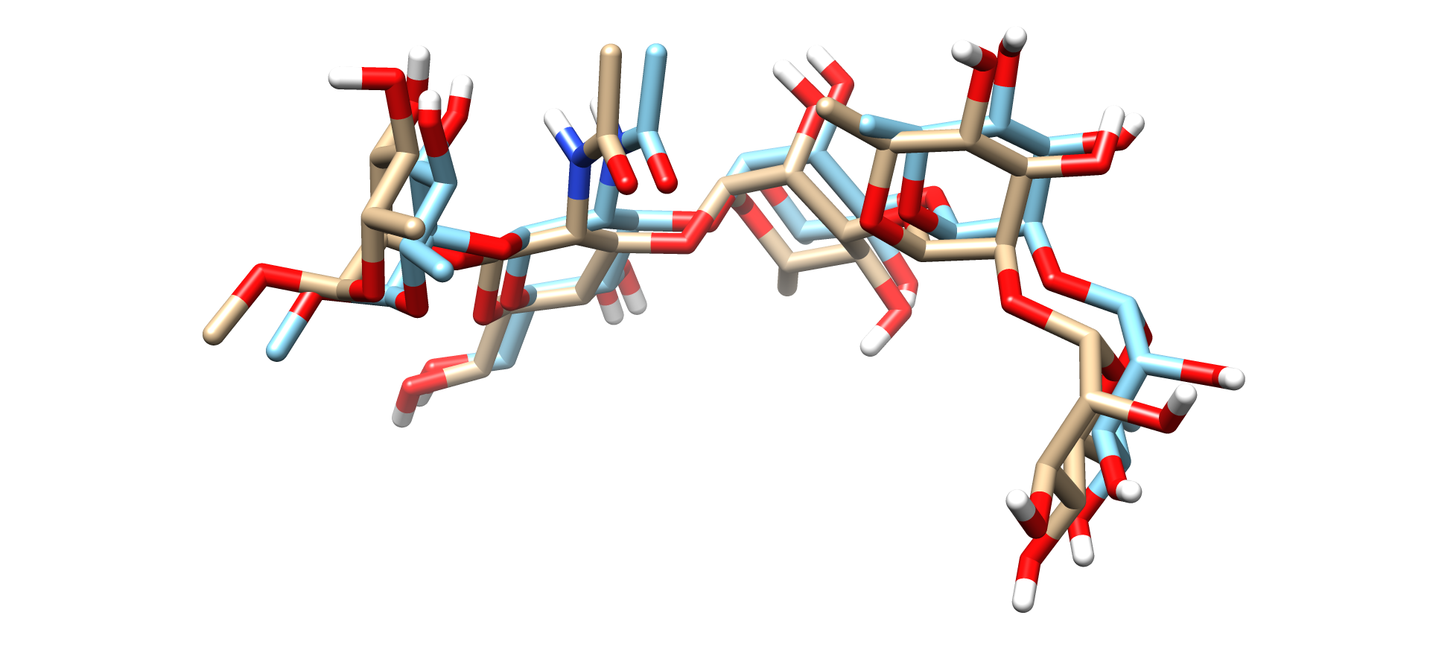
Representative and Co Crystal Structures of 1M7I

Slide 12
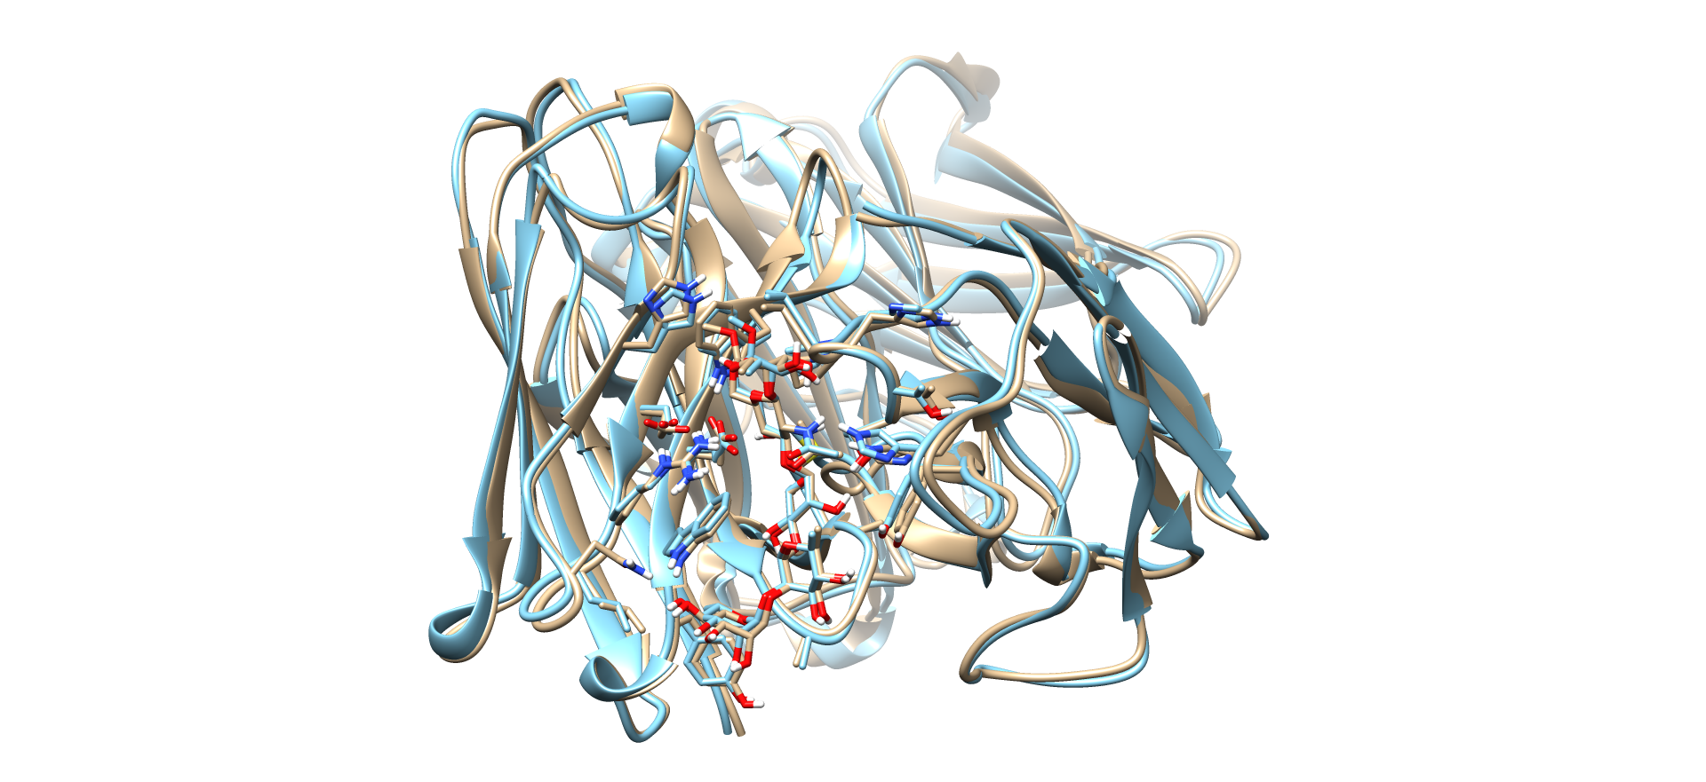
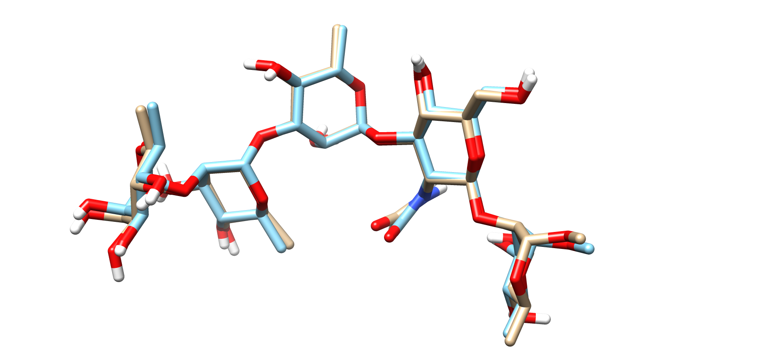
Representative and co-crystal structures of Best Docked

Slide 13
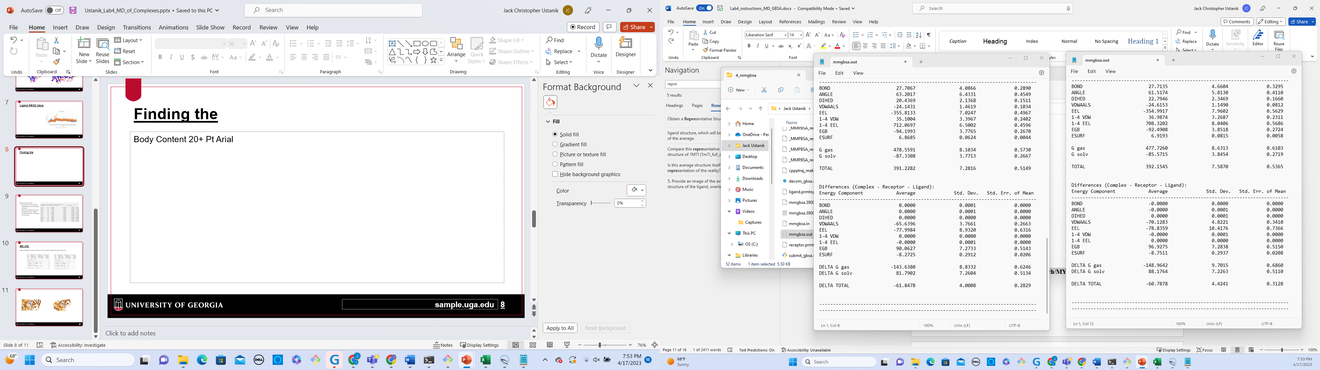
Docking Affinities of each System
$$∆G_{Binding}= ∆G_{Complex}−∆G_{Ligand}−∆G_{Receptor}$$
Crystal Structure
(-8033.4670) – (-8362.8475) – (391.2282) = -61.8478
Best Docked
(-8050.6427) – (-8382.0095) – (392.1545) = -60.7878

Slide 14
Breakdown in interaction Energies
Useful in determining which residues/interactions help stabilize the structure the most
Best Docked Trends:
Favorable Van der Waals, electrostatics, and Nonpolar solvation
Top few residues have very favorable Van der Waals and Electrostatics compared to the others
Information of top 15 residues with lowest interaction dG(kcal/mol)
Resname&index | Vdw | Electrostatics | Polar solvation | Nonpolar Solvation | total
3YB 438 | -10.5 | -22.857425 | 24.58644 | -1.600434 | -10.34933
3hA 439 | -9.57 | -8.005625 | 10.41672 | -1.131871 | -8.287171
TRP 248 | -4.4 | -0.923 | 1.12529 | -0.629437 | -4.827237
0hA 441 | -5.95 | 0.28475 | 3.003125 | -1.06748 | -3.72776
THR 96 | -2.61 | -4.68263 | 4.00159 | -0.265985 | -3.5571
2hA 440 | -4.64 | -4.221565 | 5.98513 | -0.601649 | -3.479974
VAL 99 | -1.7 | -0.470395 | 0.29537 | -0.227457 | -2.103952
ALA 318 | -1.83 | -0.991365 | 1.301615 | -0.346699 | -1.870824
TYR 37 | -2.43 | -0.3533 | 1.27717 | -0.303525 | -1.811935
2hA 437 | -3.2 | -3.740535 | 5.552495 | -0.423712 | -1.810267
GLY 320 | -1.48 | -1.46178 | 1.31302 | -0.152354 | -1.784069
OME 436 | -1.23 | -0.87748 | 0.908575 | -0.356945 | -1.557225
HIE 98 | -1.93 | -1.783955 | 2.32919 | -0.149901 | -1.538731
PRO 100 | -1.28 | 0.035955 | -0.1758 | -0.086529 | -1.503674
THR 97 | -1.21 | -2.655005 | 2.49683 | -0.11421 | -1.486785

Slide 15
Conclusions
Running MD on docked complexes is an invaluable tool to determine docking accuracy
Different RMSD calculation that help determine accuracy
Could reproduce a protein and ligand binding pose
Docking Experiment was successful

